Slide 1
LIFELINE
THE LOW-COST, IoT VITAL SIGNS MONITOR WITH REAL-TIME ILLNESS PREDICTION

Slide 2
THE NEED FOR A REMOTE PATIENT MONITOR
of people in developing countries don’t have access to hospital care¹
average cost of a conventional vital sign monitor
percentage of people in developing countries admitted to hospital due to overcrowding²
MEDICAL SPECIALISTS ARE LACKING IN RURAL AREAS
CONVENTIONAL MONITORS ARE TOO EXPENSIVE

Slide 3
THE SOLUTION: LIFELINE
LOW COST IoT DEVICE
REMOTELY STREAMS VITAL SIGN MEASUREMENTS TO A DOCTOR
DOCTORS CAN LOOK AFTER MANY PATIENTS IN MANY LOCATIONS AT ONCE

Slide 4
HOW DOES IT WORK? SENSORS:
ecg: used to derive heart rate
ppg: used to derive spo2 and respiration rate
temperature: indication of infection and inflammation

Slide 5
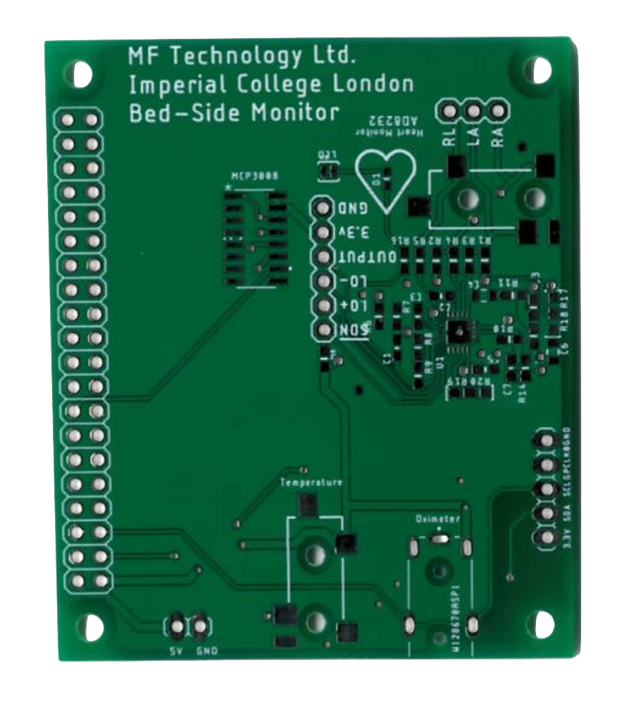
HOW DOES IT WORK? CUSTOM PCB:
CUSTOM-MADE RASPBERRY PI HAT INTERFACES SENSORS WITH ANY RASPBERRY PI

Slide 6
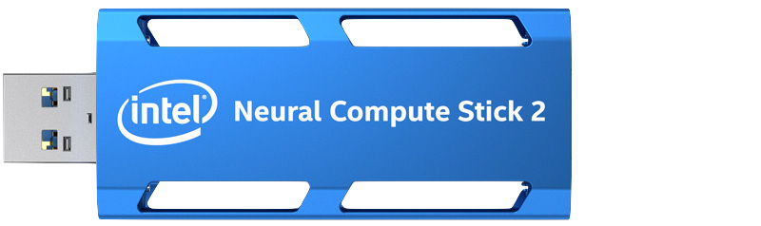
HOW DOES IT WORK? COMPUTE STICK:
runs machine learning algorithms to detect and predict atrial fibrillation and other abnormalities

Slide 7
HOW DOES IT WORK? DATABASE:
LOW-LATENCY CLOUD DATABASE STORES REAL-TIME PATIENT DATA AND PATIENT HISTORY
ENABLES DEVICE CONFIGURATION AND DOCTOR LOGIN

Slide 8
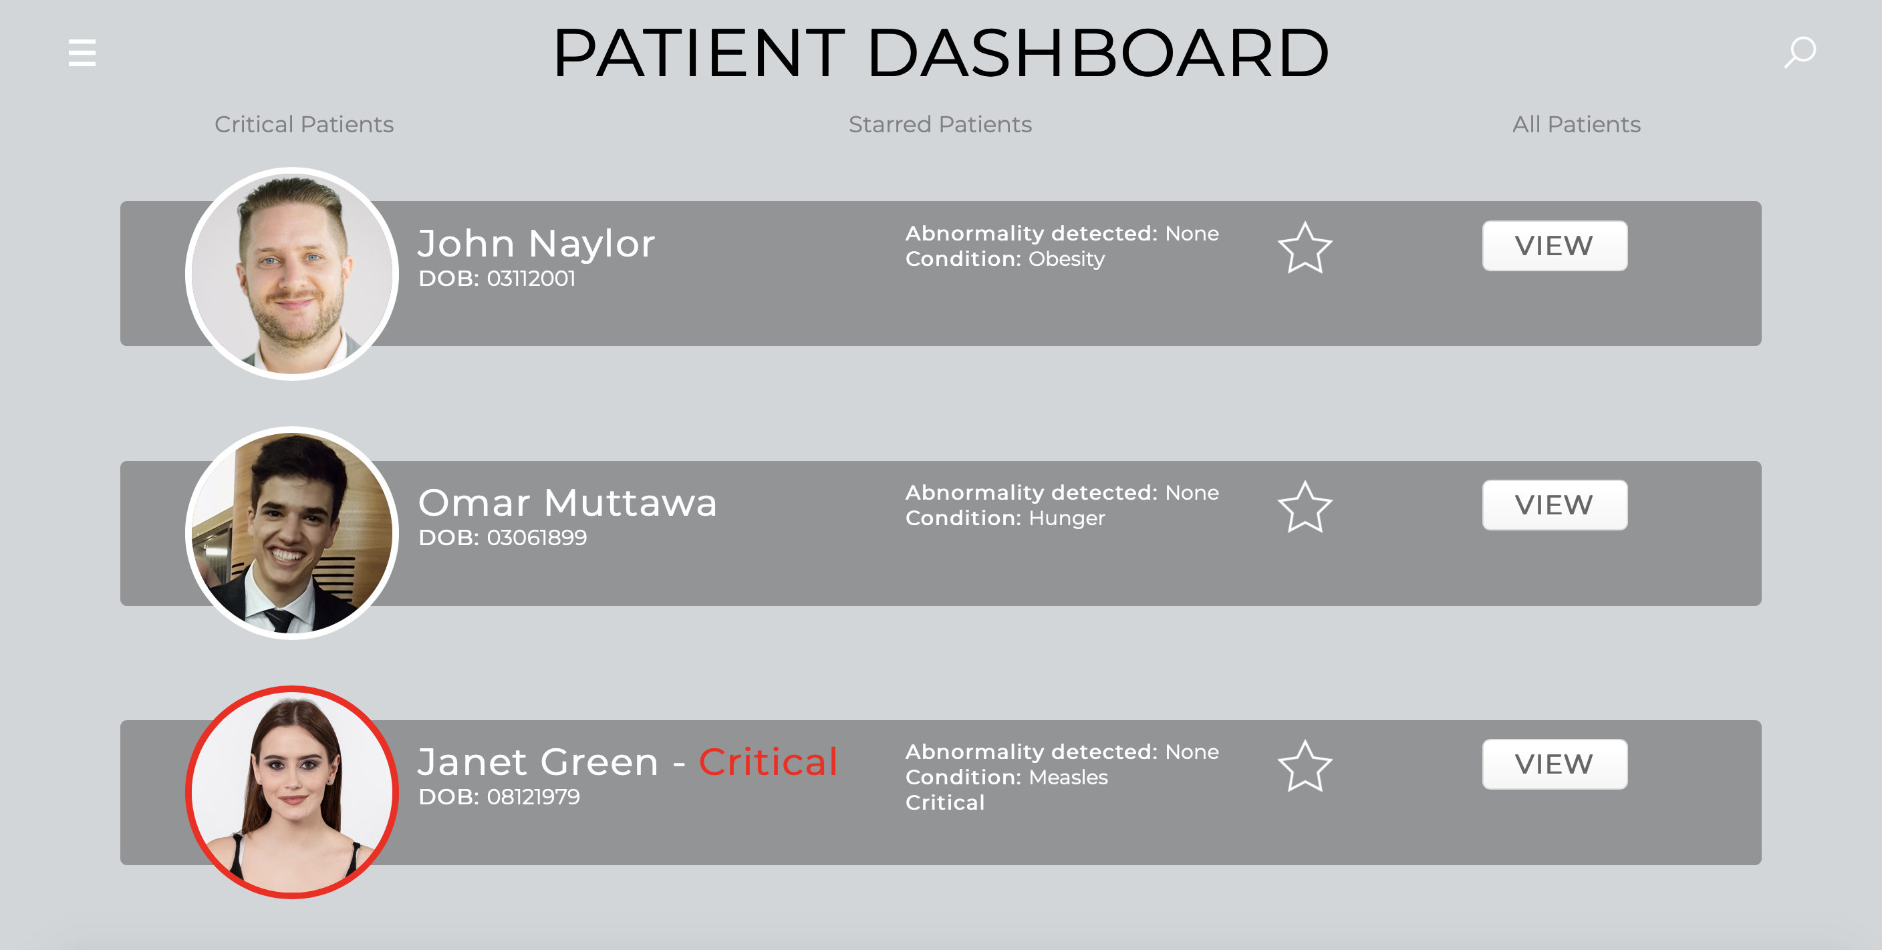
HOW DOES IT WORK? WEBAPP:
DOCTORS CAN REMOTELY MONITOR ALL THEIR PATIENTS IN REAL-TIME
VIEW PATIENT HISTORY
RECEIVE ALERTS ABOUT ABNORMALITIES

Slide 9
HOW DOES IT WORK? BEDSIDE DISPLAY:
ALLOWS REAL-TIME MONITORING AT THE BEDSIDE FOR CARERS
lets patient report a potential issue

Slide 10
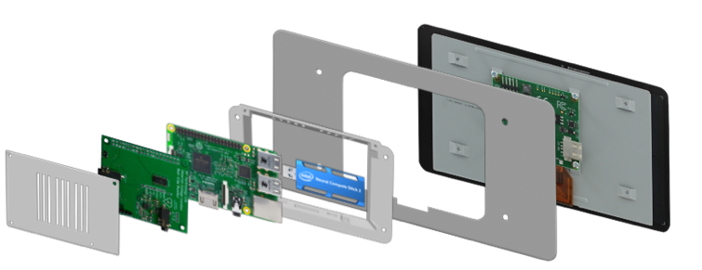
DESIGN
MODULAR DESIGN ALLOWS UNIT TO BE CUSTOMISED SPECIFIC TO PATIENT NEEDS
ENCASED IN 3D PRINTED PLA WHICH IS FULLY BIODEGRADABLE

Slide 11
COST
COSTS BETWEEN £44-£166 TO MASS PRODUCE, DEPENDING ON CHOSEN CUSTOMISATION OPTIONS
BROKEN / MISPLACED PARTS CAN BE REPLACED WITHOUT REPLACING WHOLE DEVICE
£166

Slide 12
THE FINAL PRODUCT
RASPBERRY PI HAT
PPG SENSOR
TEMPERATURE SENSOR
ECG ELECTRODES

